Slide 1










Slide 2

Architect
Senior Engineer
Junior Engineer
BREADTH of Knowledge
Stuff you know
DEPTH of Knowledge
Stuff you know you don’t know
Stuff you don’t know you don’t know

Slide 3







































































Software Engineering
(the bits AI can’t replace)

Slide 4

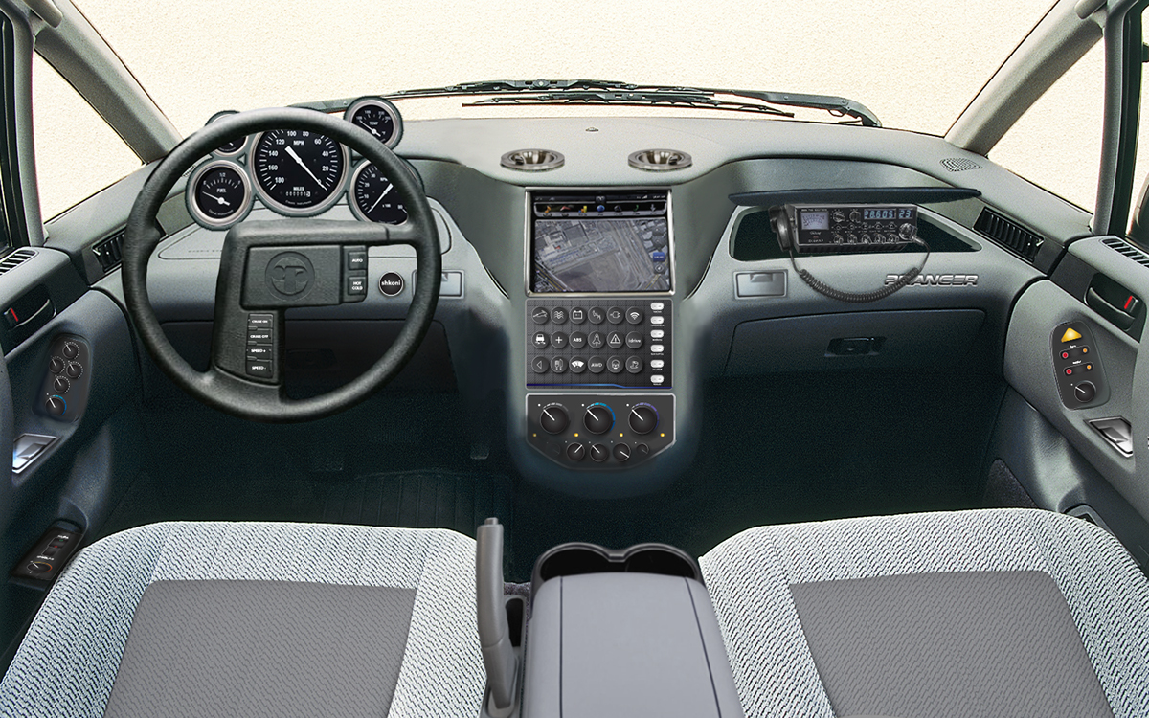
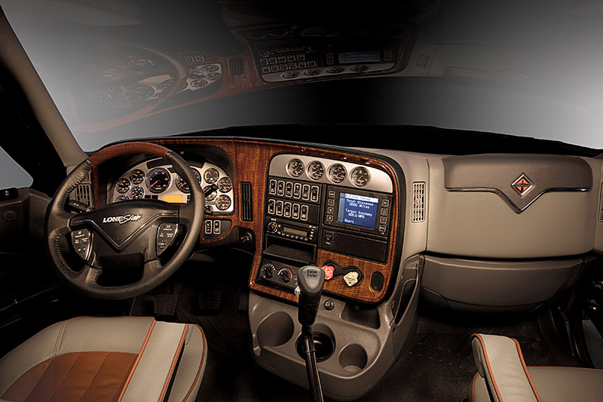
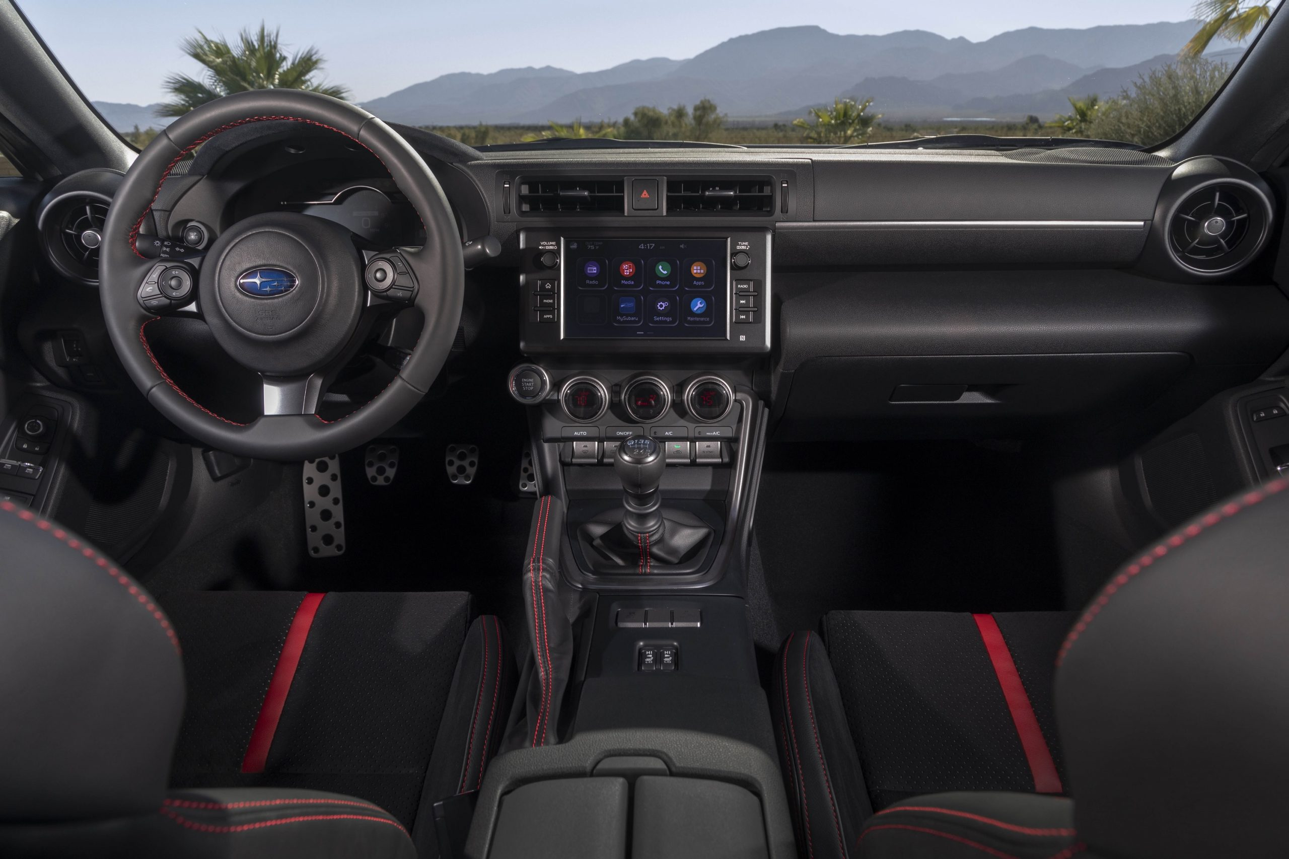
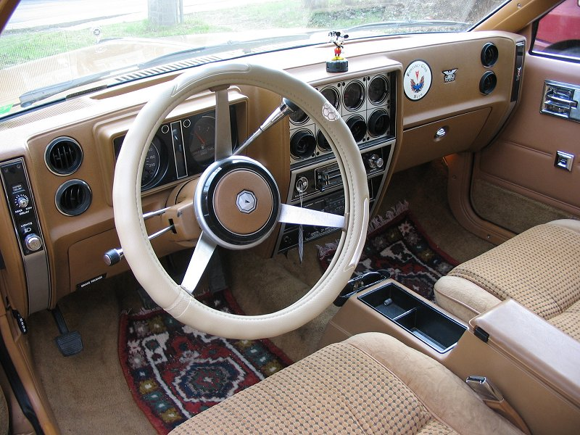
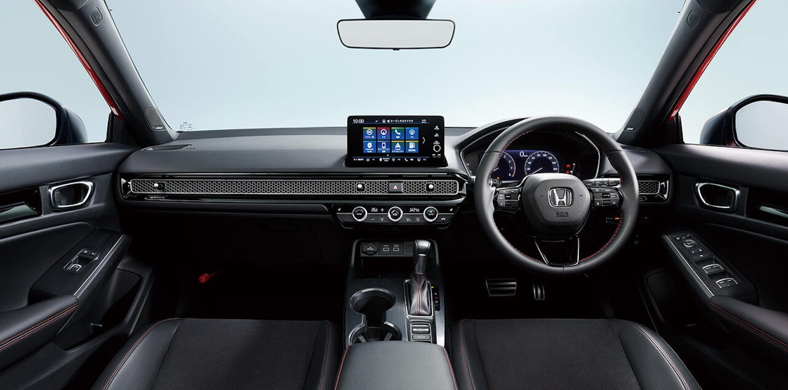
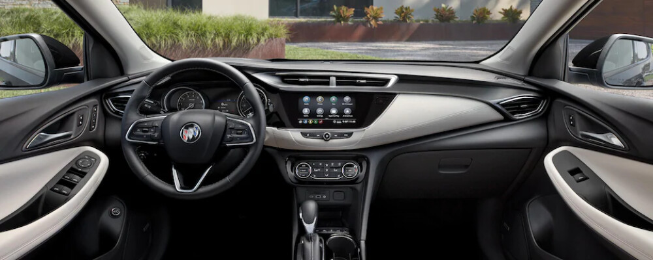
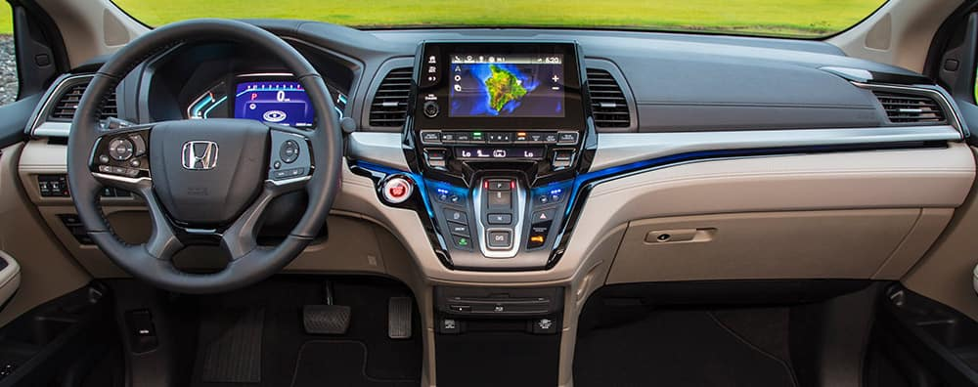

Slide 5

Core Skills
Analytical Thinking
Knowing how to learn (Growth mindset)
Creativity
Pragmatic thinking ?

Slide 6
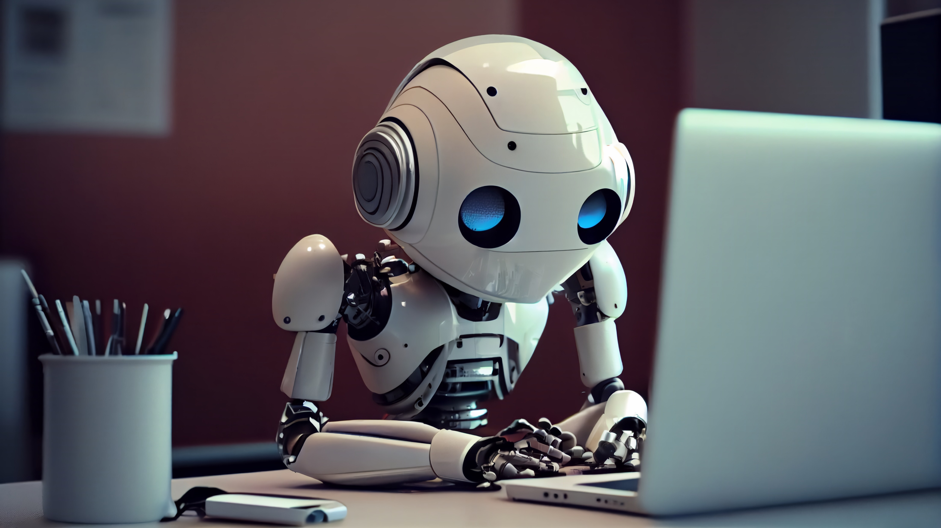
Generative AI is going to steal your job!!!

Slide 7

Technical

Slide 8
Modularity
Abstraction
Clean code

Slide 9
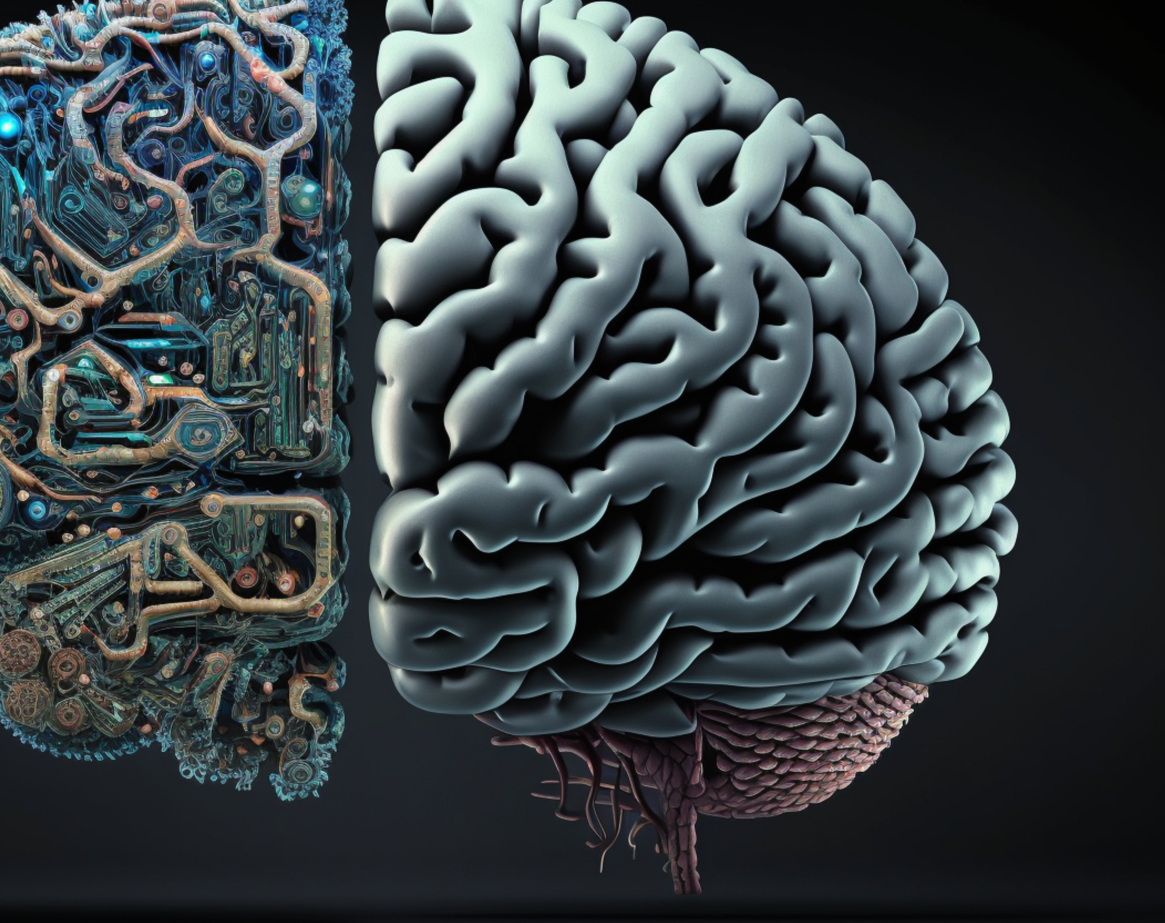
The Things AI Can’t Replace

Slide 10

Balance
ddd

Slide 11

Soft Skills

Slide 12

Growth Mindset

Slide 13


Slide 14

Attitude

Slide 15

Non-Functional Requirements
Scalability
Availability
Security
Usability
Maintainability
Reliability
Reusability
Testability
Observability

Slide 16

How to get promoted

